Slide 1
Software Analysis and Design (CS:3004)
Course Instructor: Nida Munawar
Email Address: nida.munawar@nu.edu.pk
Reference Book: Applying UML and Patterns (An introduction to Object-Oriented Analysis and Design And Iterative Development)
BY Craig Larman
Third Edition

Slide 2
The Unified Process
The Unified Process IS A
2-dimensional systems development process described by a set of phases and(dimension one) and Workflows (dimension two)

Slide 3
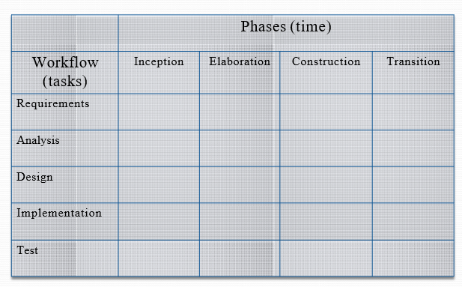
Process Overview

Slide 4
Phases
Describe the business steps needed to develop, buy, and pay for software development.
The business increments are identified as phases
Workflows
Describe the tasks or activities that a developer performs to evolve an information system over time

Slide 5
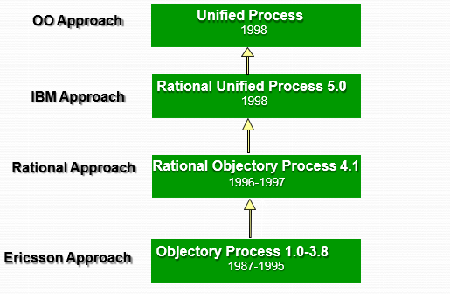
History of UP

Slide 6

UP utilizes Millers Law(An Incremental Process )
It is often interpreted to argue that the number of objects an average human can hold in short-term memory is 7 ± 2

Slide 7
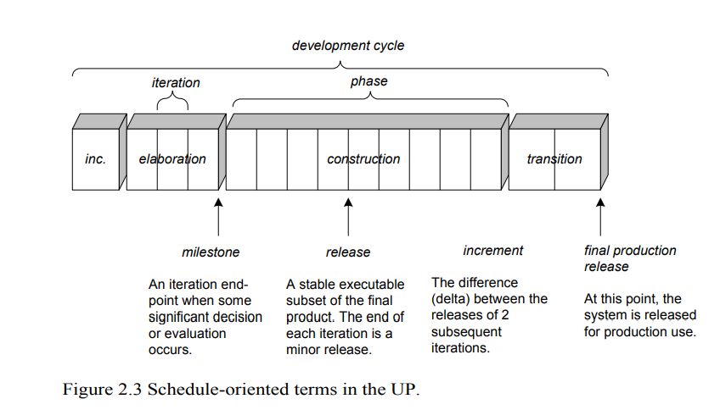
ITERATIVE DEVELOPMENT AND THE UNIFIED PROCESS

Slide 8
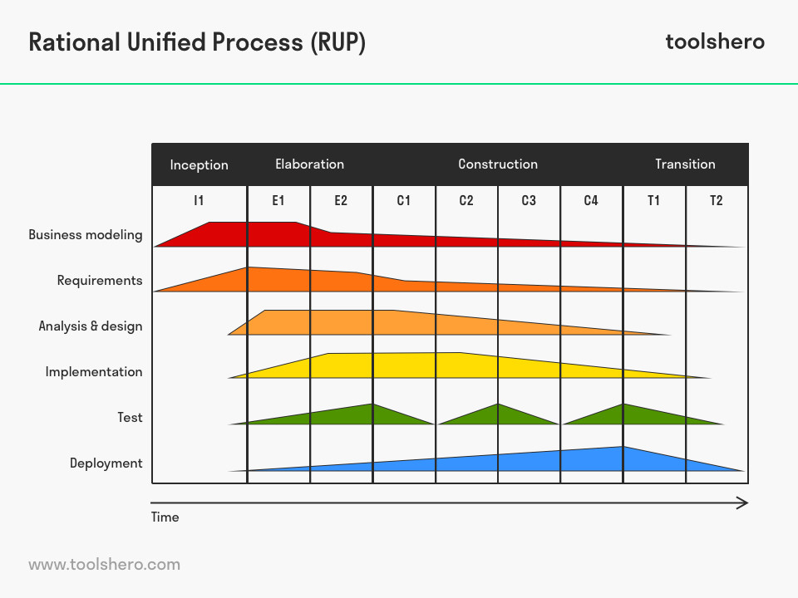

Unified Process:
It is an iterative approach
It is an iterative model

Slide 9

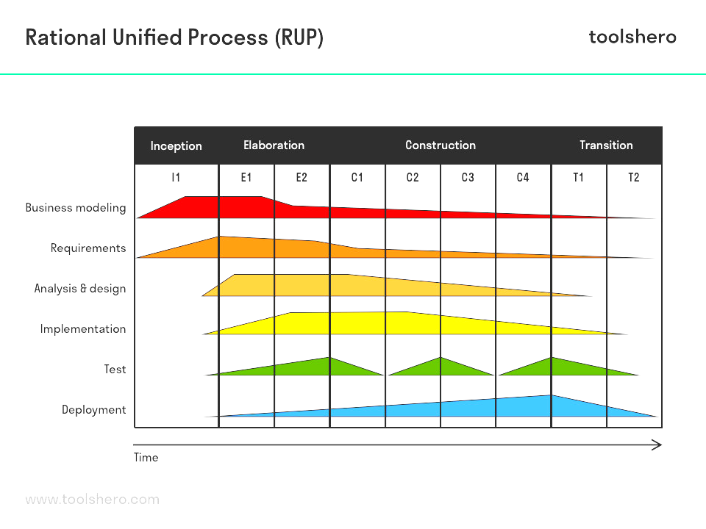

Unified Process:
Inception:
Short phase
Business case and vision is established (Why?)
Scope
Feasibility study
Build vs Buy(is it better to build ourselves or should we just get it
off the shelf or buy or have someone build it for us?)
Should we proceed or stop?
Preliminary budget and cost estimation(rough estimates)
Milestone: at the end of this phase, you have this milestone called Lifecycle Objective

Slide 10
Unified Process:
Elaboration:
Requirements Specification
Validate Architecture
Establish Executable Architecture
Figure out risks
Milestone : Lifecycle Architecture,

Slide 11
Unified Process:
Construction: (Release)
Largest phase
Software construction
Iterative and incremental
Multiple iterations each iteration results in a release
you release something and you get some kind of a feedback
Milestone : Initial Operational Capability

Slide 12
Unified Process:
Transition: (Final Production Release)
Deployment
Stakeholder Feedback(customer, product manager, etc.)
old system to the new system migration
User Training

Slide 13
Unified Process Phases
Inception
Define business case, risks, 10% requirements identified, estimate next phase effort.
Elaboration
Understanding of problem / architecture, risk significant units are coded/tested, 80% requirements identified.
Construction
System design, programming and testing.
Transition
Deploy the system in its operating environment.

Slide 14
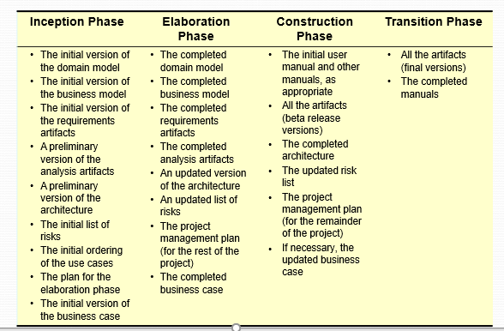
Phase Deliverables

Slide 15
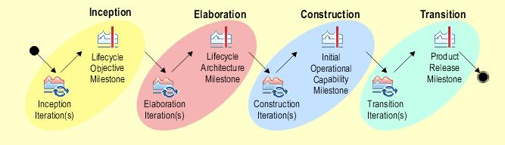
Characteristics:
It is a framework(you can use any of your other models as part of this framework)
every step requires all of these different software processes
Architecture Centric
User centric(Utilizes use case model to describe complete functionality of the system)
Focus on risk mitigation

Slide 16
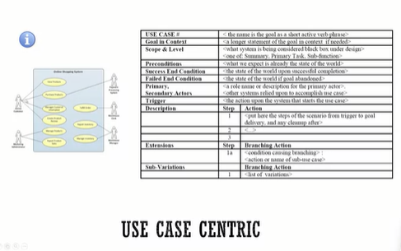
User centric

Slide 17

Predictive or Adaptive?

Slide 18

Unified Process:
Pros:
Adaptive Process
Risk mitigation
Quality
Flexible incorporate with other models.
Cons:
Complex framework
Overheads
Use:
For riskier projects
Requirements not known in early stages
Deliver value earlier

Slide 19
UP Artifacts:
Business Modeling: the domain model artifact
Requirements: The Use-Case model artifact
Design: The design model artifact

Slide 20
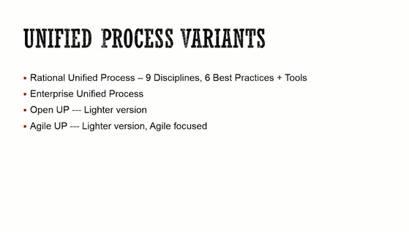
UP variants

Slide 21
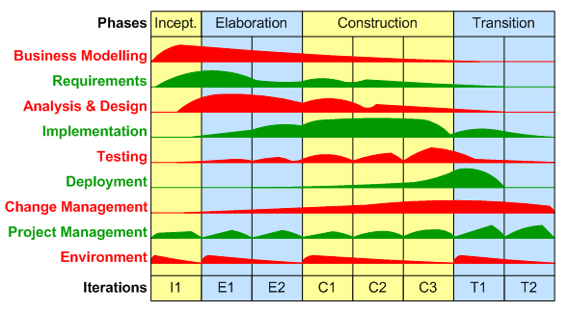
Rational unified Process: (RUP)
Most Popular Variant of UP.
RUP was evolved into AUP by Scott ambler.
4 phases, 9 key disciplines.

Slide 22




Primary Workflows
 The Unified Process
PRIMARY WORKFLOWS
Requirements workflow
Analysis workflow
Design workflow
Implementation workflow
Test workflow
Post delivery maintenance workflow
Supplemental Workflows
Planning Workflow

Slide 23
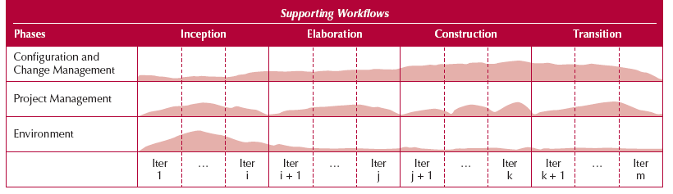
Supporting Workflows of The Unified Process

Slide 24
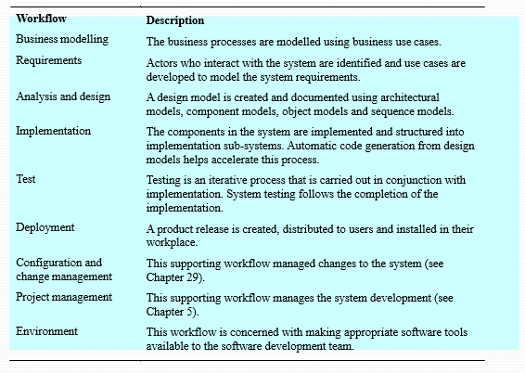
workflows

Slide 25
Six best “must” UP practices
In RUP it is recommended to follow six practices, which allow to develop the project successfully :
iterative development;
requirements management;
use of modular architectures;
visual modeling;
quality checking;
tracking changes.

Slide 26

Six best “must” UP practices
Time-boxed iterations: avoid speculative powerpoint
architectures”
—date slippage is discouraged
Strive for cohesive architecture and reuse existing components:
e.g. core architecture developed by small, co-located team
then early team members divide into sub-project leaders

Slide 27

Six best “must” UP practices
Continuously verify quality: test early & often, and realistically by integrating all software at each iteration
Visual modeling: prior to programming, do at least some visual modeling to explore creative design ideas

Slide 28

Six best “must” UP practices
Manage requirements: find, organize, and track requirements through skillful means
Manage change:
disciplined configuration management protocol, version control,
change request protocol
baselined releases at iteration ends

Slide 29
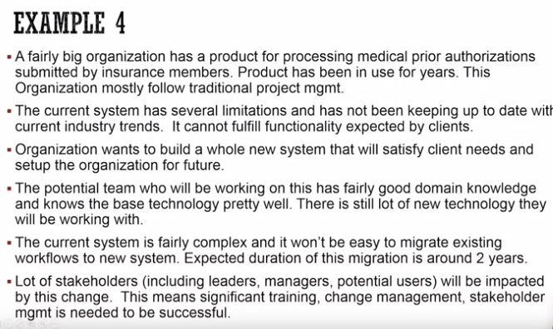
Task

Slide 30
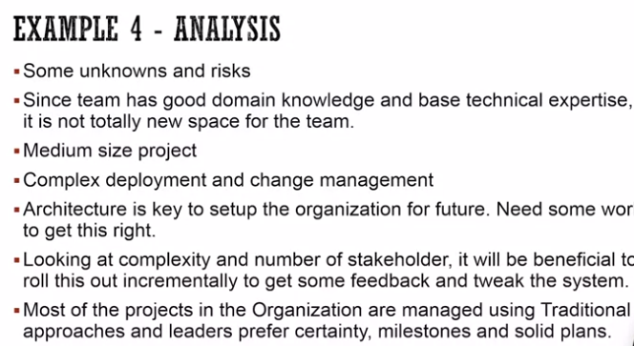
Analysis

Slide 31
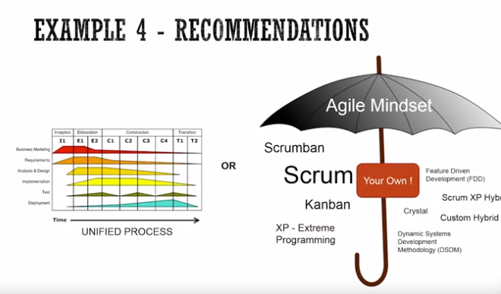
Solution

Slide 32
Situation to read:
As a software development professional, you will run into all kinds of projects and situations within those projects. This assignment is designed to present you with a fictitious situation and ask you to recommend a software development approach suited to the situation.
Here is the situation:
Zenith Healthcare is a new company in the market and has launched its product two years ago. The product is loved by clients and is growing in popularity. The level of product demand was not anticipated, and the current system architecture cannot support the rising demand. To support the anticipated demand, the company needs to re-architect the system and provide the exact same functionality. Thus, the requirements from the client perspective are very well known and do not need to change. What needs to be changed in the system to support the growing demand is also well understood. The product has 4, fairly independent components. All 4 components need to be re-architected. Out of the 4, one of them has caused the most pain and the organization could benefit greatly if that component could be replaced first with a new, highly scalable architecture. The work of migrating to a new platform is a tedious job and the deployment of a new system will involve a lot of external communication, managing customer expectations, etc.
The technical architect and one project manager will be working from the corporate headquarters in Germany, but most of the team who will be doing the coding for the migration will be offshore in Belarus. The testing team will also be in Belarus.

Slide 33


Slide 34

Planning Workflow
Define scope of Project
Define scope of next iteration
Identify Stakeholders
Capture Stakeholders expectation
Build team
Assess Risks
Plan work for the iteration
Plan work for Project
Develop Criteria for iteration/project closure/success
UML concepts used: initial Business Model, using class diagram

Slide 35

Requirements Workflow
Workflow (tasks)
Requirements
Analysis
Design
Implementation
Testing
Primary focus
 To determine the client’s needs by eliciting both functional and nonfunctional requirements
Gain an understanding of the
application domain
Described in the language of the customer

Slide 36

Requirements Workflow
Workflow (tasks)
Requirements
Analysis
Design
Implementation
Testing
The aim is to determine the client’s needs
First, gain an understanding of the domain
How does the specific business environment work
Second, build a business model
Use UML to describe the client’s business processes
If at any time the client does not feel that the cost is justified, development terminates immediately
It is vital to determine the client’s constraints
Deadline -- Nowadays software products are often mission critical
Parallel running
Portability
Reliability
Rapid response time
Cost
The aim of this concept exploration is to determine
What the client needs, and
Not what the client wants

Slide 37

Requirements Workflow
Workflow (tasks)
Requirements
Analysis
Design
Implementation
Testing
List candidate requirements
textual feature list
Understand system context
domain model describing important concepts of the context
business modeling specifying what processes have to be supported by the system using Activity Diagram
Capture functional and nonfunctional requirements
Use Case Model
Supplementary requirements
physical, interface, design constraints, implementation constraints

Slide 38

Analysis Workflow
Workflow (tasks)
Requirements
Analysis
Design
Implementation
Testing
Primary focus
 Analyzing and refining the requirements to achieve a detailed understanding of the requirements essential for developing a software product correctly
To ensure that both the developer and user organizations understand the underlying problem and its domain
Written in a more precise language

Slide 39

Analysis Workflow
Workflow (tasks)
Requirements
Analysis
Design
Implementation
Testing
The aim of the analysis workflow
To analyze and refine the requirements
Two separate workflows are needed
The requirements artifacts must be expressed in the language of the client
The analysis artifacts must be precise, and complete enough for the designers
Specification document (“specifications”)
Constitutes a contract
It must not have imprecise phrases like “optimal,” or “98 percent complete”
Having complete and correct specifications is essential for
Testing, and
Maintenance
The specification document must not have
Contradictions
Omissions
Incompleteness

Slide 40

Analysis Workflow
Workflow (tasks)
Requirements
Analysis
Design
Implementation
Testing
Structure the Use Cases
Start reasoning about the internal of the system
Develop Analysis Model: Class Diagram and State Diagram
Focus on what is the problem not how to solve it
Understand the main concepts of the problem
Three main types of classes stereotypes may be used:
Boundary Classes: used to model interaction between system and actors
Entity Classes: used to model information and associated behavior deirectly derived from real-world concept
Control Class: used to model business logic, computations
transactions or coordination.
The specification document must not have
Contradictions
Omissions
Incompleteness

Slide 41

Design Workflow
Workflow (tasks)
Requirements
Analysis
Design
Implementation
Testing
 The aim of the design workflow is to refine the analysis workflow until the material is in a form that can be implemented by the programmers
 Determines the internal structure of the
software product

Slide 42

Design Workflow
Workflow (tasks)
Requirements
Analysis
Design
Implementation
Testing
The goal is to refine the analysis workflow until the material is in a form that can be implemented by the programmers
 Many nonfunctional requirements need to be finalized at this time, including: Choice of programming language, Reuse issues, Portability issues.
Classical Design
Architectural design
Decompose the product into modules
Detailed design
Design each module using data structures and algorithms
Object Oriented Design
Classes are extracted during the object-oriented analysis workflow, and
Designed during the design workflow

Slide 43

Design Workflow
Workflow (tasks)
Requirements
Analysis
Design
Implementation
Testing
General Design
Refine the Class Diagram
Structure system with Subsystems, Interfaces, Classes
Define subsystems dependencies
Capture major interfaces between subsystems
Assign responsibilities to new design classes
Describe realization of Use Cases
Assign visibility to class attributes
Design Databases and needed Data Structures
Define Methods signature
Develop state diagram for relevant design classes
Use Interaction Diagram to distribute behavior
among classes
Use Design Patterns for parts of the system

Slide 44

Design Workflow
Workflow (tasks)
Requirements
Analysis
Design
Implementation
Testing
Architectureal Design
Identify Design Mechanisms
Refine Analysis based on implementation environment
Characterize needs for specific mechanisms (inter-process communication, real-time computation, access to legacy system, persistence, …)
Assess existing implementation mechanisms
Identify Design Classes and Subsystems
A Subsystem is a special kind of Package which has behavioral semantics (realizes one or more interfaces)
Refine analysis classes
Group classes into Packages
Identify Subsystems when analysis classes are complex
Look for strong interactions between classes
Try to organize the UI classes into a subsystem
Separate functionality used by different actors in different subsystems
Separate subsystems based on the distribution needs
Identify Interfaces of the subsystems

Slide 45
Implementation Workflow
Workflow (tasks)
Requirements
Analysis
Design
Implementation
Testing
 The aim of the implementation workflow is to implement the target software product in the selected implementation language

Slide 46

Implementation Workflow
Workflow (tasks)
Requirements
Analysis
Distribute the system by mapping executable components onto nodes in the deployment model
Implement Design Classes and subsystems through
packaging mechanism:
 package in Java, Project in VB, files directory in C++
Acquire external components realizing needed interfaces
Unit test the components
Integrate via builds
Design
Implementation
Testing

Slide 47

Test Workflow
Workflow (tasks)
Requirements
Analysis
Design
Implementation
Testing
Carried out in parallel with other workflows
Primary purpose
To increase the quality of the evolving
system
The test workflow is the responsibility of
Every developer and maintainer
Quality assurance group

Slide 48

Test Workflow
Workflow (tasks)
Requirements
Analysis
Design
Implementation
Testing
Develop set of test cases that specify what t in the system
many for each Use Case
each test case will verify one scenario of the use case
based on Sequence Diagram
Develop test procedures specifying how to perform test cases
Develop test component that automates test procedures
o test

Slide 49

Deployment Workflow
Activities include
Software packaging
Distribution
Installation
Beta testing

Slide 50
Deployment Workflow

Producing the Software
Output of implementation is tested executables.
Must be associated with other artifacts to constitute a complete product:
Installation scripts User documentation Configuration data
Additional programs for migration: data conversion.
In some cases:
different executables needed for different user configurations different sets of artifacts needed for different classes of users:
new users versus existing users,
variants by country or language

Slide 51
Deployment Workflow

Producing the Software (continued)
For distributed software, different sets may have to be produced for different computing nodes in the network Packaging the Software
Distributing the Software
Installing the Software
Migration
Providing Help and Assistance to Users
Acceptance

Slide 52

Software Project Management Plan
 Once the client has signed off the specifications, detailed planning and estimating begins
We draw up the software project management plan, including
Cost estimate
Duration estimate
Deliverables
Milestones
Budget
This is the earliest possible time for the SPMP

Slide 53
Post delivery Maintenance
Post delivery maintenance is an essential component of software development
More money is spent on post delivery maintenance than on all other activities
combined
Problems can be caused by
Lack of documentation of all kinds
Two types of testing are needed
Testing the changes made during post delivery maintenance
Regression testing
All previous test cases (and their expected outcomes) need to be retained

Slide 54

Retirement
Software is can be made unmaintainable because
A drastic change in design has occurred
The product must be implemented on a totally new hardware/operating system
Documentation is missing or inaccurate
Hardware is to be changed—it may be cheaper to rewrite the software from
scratch than to modify it
These are instances of maintenance (rewriting of existing software)
True retirement is a rare event
It occurs when the client organization no longer needs the functionality
provided by the product

